Slide 1
Off-target splice analysis of
Risdiplam and Branaplam
For GTxAU
Dann Huh
01/05/2023

Slide 2
Acknowledgment
Splicing analysis and the pipeline
Matt Ryals (BSSI)
Kai Hu
Eric Marshall
Jessica Hurt
Ellen Tsai
RNA-seq
Ravi Challa
Mei Liu
Thomas Carlile
Chao Sun
Cells and project
Paige Cundiff
Mercedes Beyna
Susanne Swalley

Slide 3
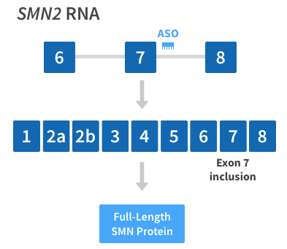
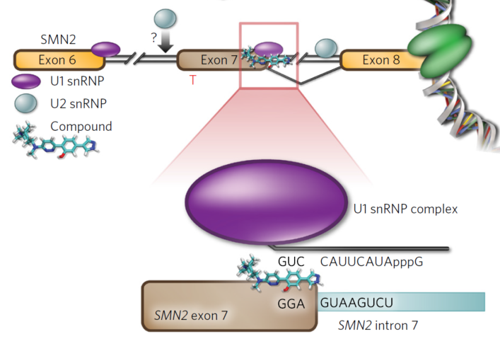
Small molecules (SM) can do what Spinraza does
Spinraza
SM, e.g, Branaplam, Risdiplam
[Palacino J, 2015]
But what about off-targets, if the SM recognizes the local environment,
i.e., the RNA sequence?

Slide 4
Experimental setup: RNA-seq on SMA-derived cell lines
Fibroblast (TST11354)
iPSC-MN(TST11451)
Cell line : SMN1 ex7-8 del fibroblast
Compound: BIO-1790727
Branaplam
Risdiplam
Dose : 01x, 03x, 10x, 30x of EC50
Time : 24 hour after compound treatment
Replicates: Each treatment X3, DMSO control X 6.
Cell line : iPSC from GM24468D,
HNDS006-01C2,
HNDS0030-01 (SMA)
differentiated to iPSC-MN, D14.
Compound: Risdiplam
Dose : 4, 40, 120, 400 nM (EC50 = 40nM for iPSCMN)
Time : 24 hour after the compound treatment
Replicates: Each treatment X4, DMSO control X 4
(except for HNDS0030-01 with 5 replicates of DMSO control)
Question: What other genes than SMN2 are spliced upon SM treatment?
RNA-seq (then mapped to hg19 annotation without SMN1 )
Monitor local splice difference for each treatment vs DMSO control

Slide 5
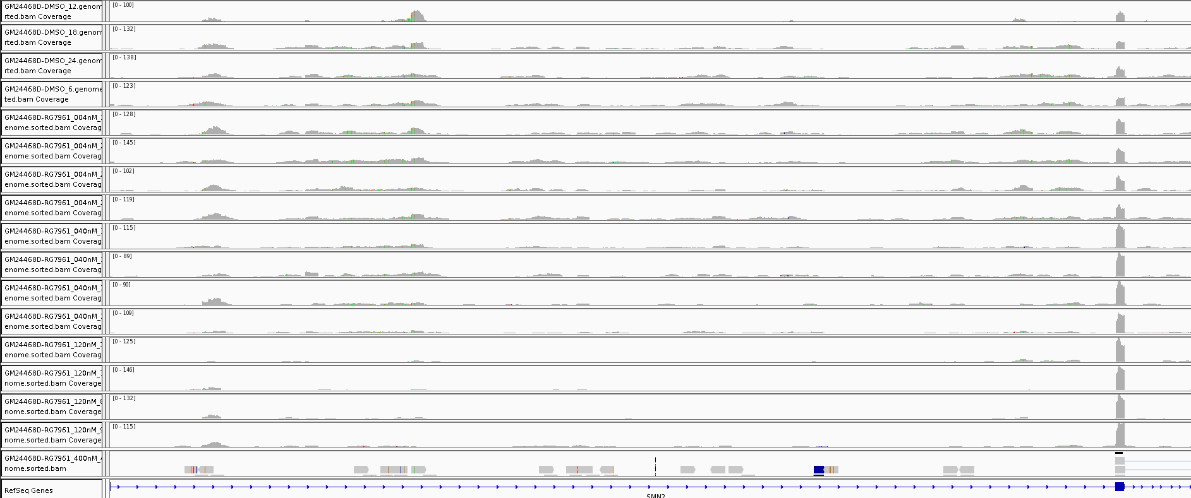
Example: SMN2 exon7 inclusion after Risdiplam treatment
GM24468D
DMSO
DMSO
004nM
004nM
040nM
040nM
120nM
120nM
➔ Let’s quantify such events, comprehensively.

Slide 6
Splice analysis packages

Slide 7
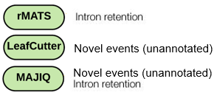
Three different algorithms are used for splice analysis
Focusing on local splicing event rather than full quantification of splice isoforms
C₁+C₃
C₁+2*C₂+C₃
C₁
C₃
Measure1: Percent Spliced In : e.g., exon skipping:
Ψ=
C₂
Measure2: dPSI = ΔΨ = Ψ_{treatment} - Ψ_{control}
Input: read counts from RNA-seq
Most straightforward interpretation;
low-counts are not handled well
Different definition of “PSI”;
Intron centric
Different definition of “PSI”;
Junction centric;
Bayesian interpretation (no p.val)
Output: PSI and dPSI with statistical significance
All three algorithm use
different statistical models
Eric Marshall, Ellen Tsai, Jessica Hurt

Slide 8
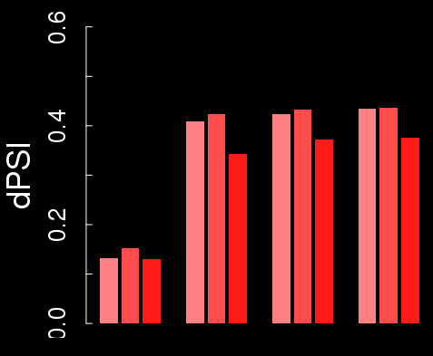
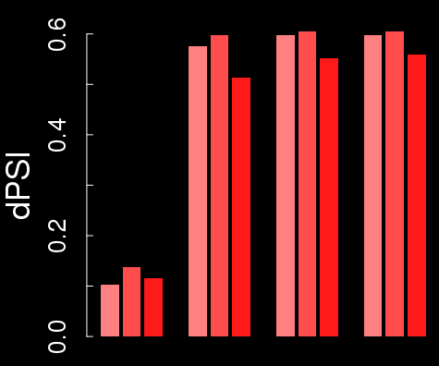
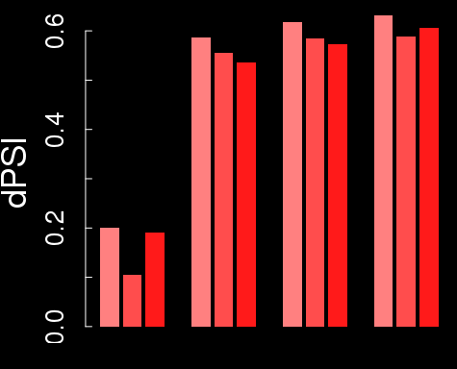
Example: Delta-PSI of SMN2 exon7 is around 60% in iPSC-MN
rMATS
Leafcutter
Majiq
GM24468D
HNDS006-01C2
HNDS0030-01
FDR
0.02
0.33
0.001
FDR
0.59
0.37
0.59
004 040 120 400nM
004 040 120 400nM
004 040 120 400nM
dPSI ~ 60%, which is higher than ~50% seen in fibroblast.
➔ (1) baseline PSI in untreated SMA iPSC-MN is ~40%, different from fibroblast.
(2) Risdiplam bring PSI close to 100%, as in fibroblast.
Notes:
Junc_coords: hg19, chr5:69366578-69372846

Slide 9
The difference in SMN2 dPSI between algorithms comes from varying definitions of “PSI”
rMATS : does not even use the word PSI, just called “Inclusion Level Difference”
Leafcutter: “Percent Spliced In”
Majiq: “Percent Selected Index” (one junction at a time)
<DMSO>
<RG7916>
C₁=16
C₃=29
C₁=54
C₃=79
Example:
Delta
C₂=20
C₂=0
rMATS
C₁+C₃
C₁+2*C₂+C₃
0.53
1.0
0.47
Leafcutter
C₁+C₃
C₁+C₂+C₃
0.69
1.0
0.31
Majiq
C₁ C₃
C₁+C₂ C₂+C₃
or
0.44 or 0.59
1 or 1
0.56 or 0.41

Slide 10
Data example from the master table
➔Currently working on “harmonizing” data output from three algorithms

Slide 11
Parameters for thresholding to define differentially spliced genes (DSG):
rMATS: FDR<0.05, dPSI> 0.30
Leafcutter: FDR<0.05, dPSI > 0.20
Majiq: P(dPSI) > 0.90, E(dPSI)>0.30

Slide 12
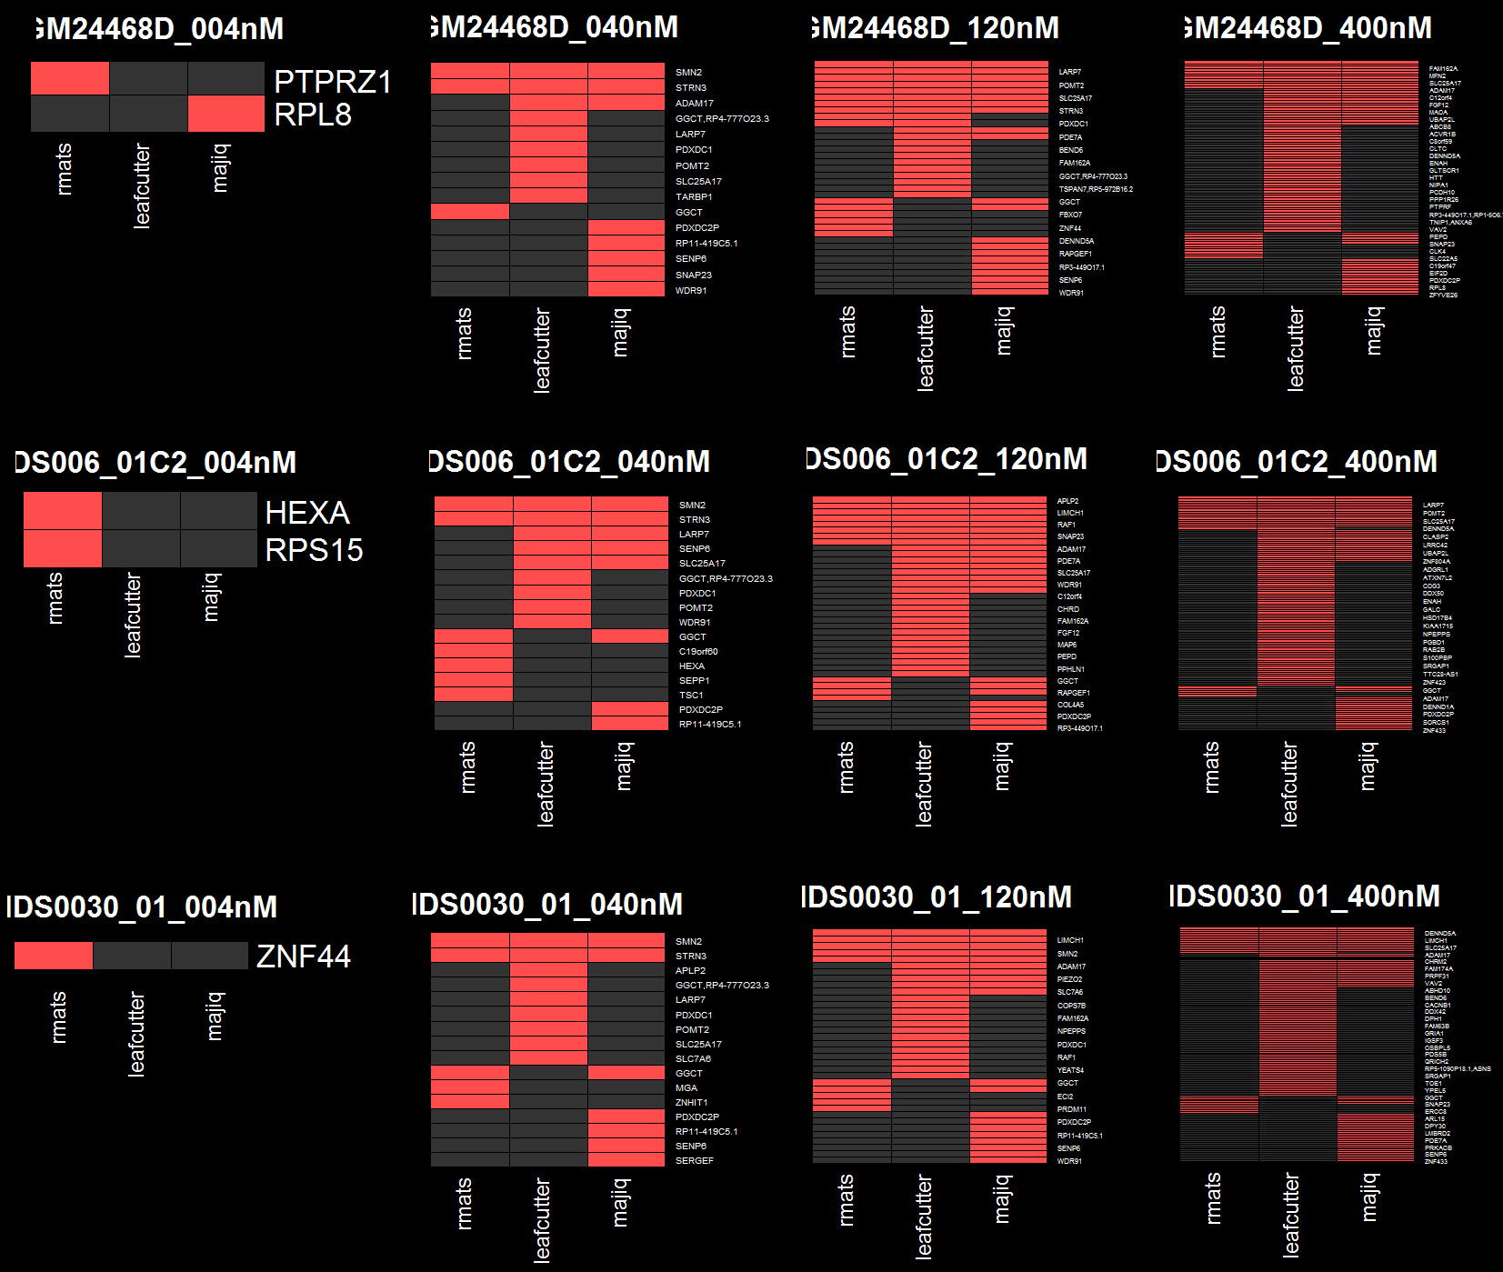
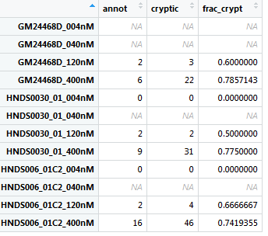
The DSG list do not always agree across algorithms
004nM
040nM
120nM
400nM
(1) rMATS relies on annotation, while
Leafcutter and Majiq do not.
GM24468D
Genes in Leafcutter,
not in rMATS or Majiq:
Most un-annotated, as in fibroblast
HNDS006_01C2
HNDS0030_01
(2) rMATS detects intron retention, while
Leafcutter does not.
➔ However, this does not explain rMATS-specific DSG (data not shown)
colored = genes that has local spice event that passed the filter.
➔ Take the UNION of all three packages

Slide 13
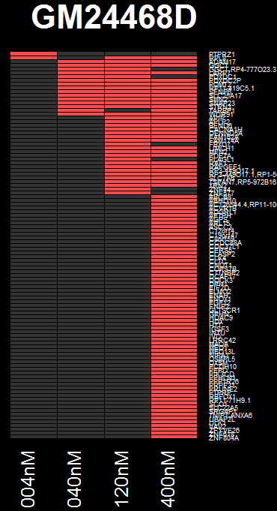
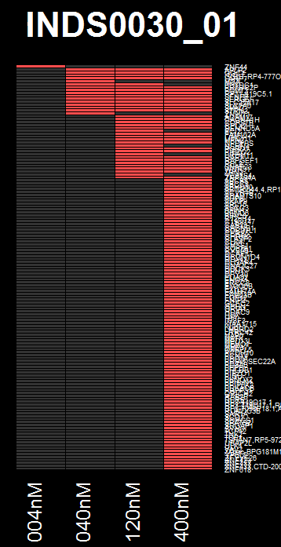
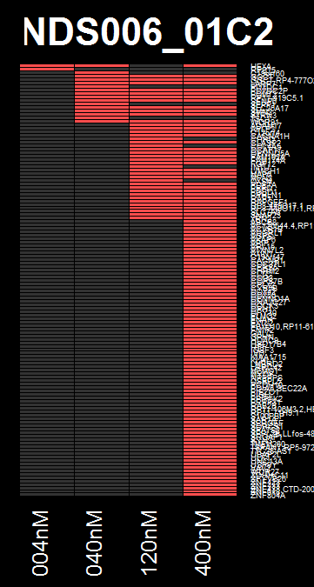
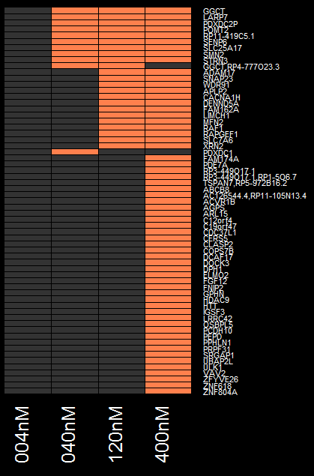
iMN: Common DSG across different cell lines
GGCT
LARP7
PDXDC2P
POMT2
RP11-419C5.1
SENP6
SLC25A17
SMN2
STRN3
Common genes
ADAM17
SNAP23
WDR91
APLP2
CACNA1H
DENND5A
FAM162A
LIMCH1
MFN2
RAF1
RAPGEF1
SLC7A6
XRN2
rMATS: FDR<0.05, dPSI> 0.30
Leafcutter: FDR<0.05, dPSI > 0.20
Majiq: P(dPSI) > 0.90, E(dPSI)>0.30
➔ UNION of genes
NB: DSG are not always consistent with increasing dose
0, 11, 23, 61 genes
Notes:
C:\Users\dhuh\Desktop\Project\SMA\TST11451_SMASM_iPSCMN\analysis\analysis_02_combined_DSG\res.02.compare_plot_DSG_abThr\DSG_per_cellline_per_dose
C:\Users\dhuh\Desktop\Project\SMA\TST11451_SMASM_iPSCMN\analysis\analysis_02_combined_DSG\res.02.compare_plot_DSG_abThr\DSGoverlap_genes_per_dose.txt
TEX21P: minFDR=0.51, Not significant anywhere
Average expression:
iPSCMN : 1.77
fibroblast: 1.85
iPSCMNSMA: 0.26

Slide 14
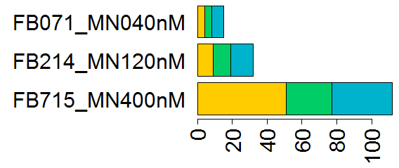
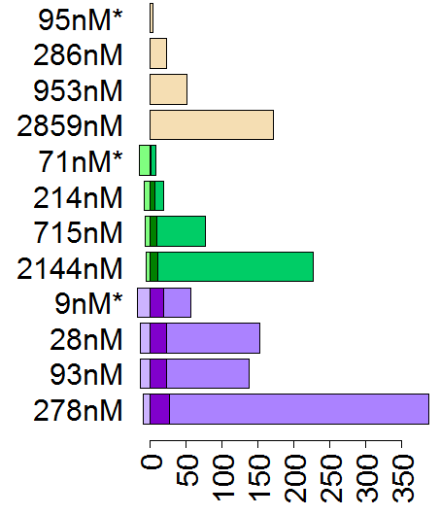
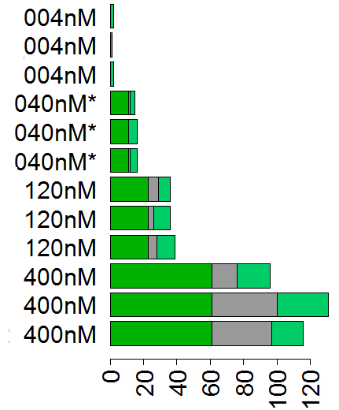
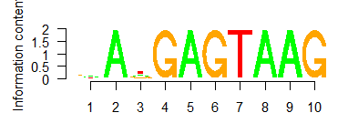
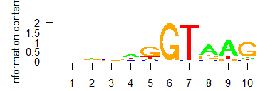
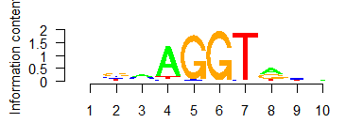
Off-target splicing statistics for three compounds tested in SMA fibroblast and iPSC-MN
Fibroblast: more splice off-targets
are detected than reported
iPSC-MN: ~40% off-targets
are cell-line specific
Fibroblast ≠ iPSC-MN:
~25% of DSG are shared
Current expr only
1
Unique to cell line
BIO
1790727
In both
2
Cell lines
In 2 cell lines
Publication^{[1]} only
|dPSI|>0.3
3
In all 3
Fibroblast only
…
Number of DSG
Shared
iPSC-MN only
Risdiplam
Off-targets can have
mismatched motifs
Branaplam
Most enriched
3-mismatch
Number of DSG
Number of DSG
Risdiplam has fewer off-targets
than Branaplam
Number of off-targets is
similar to fibroblast
5-mismatch
[1] Sivaramakhrisian, 2017
(*EC50)

Slide 15
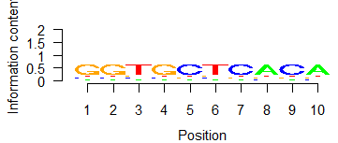
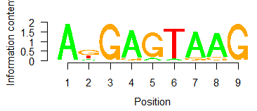
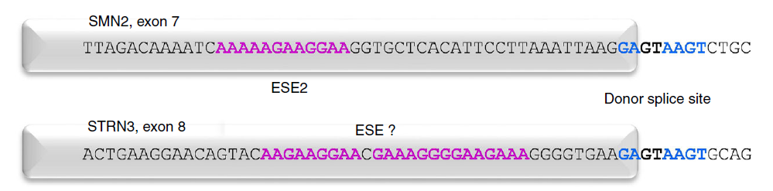
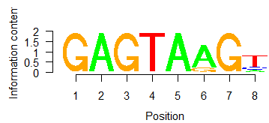
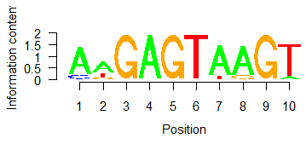
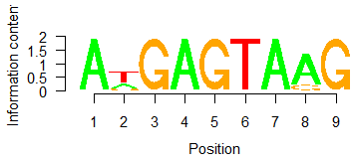
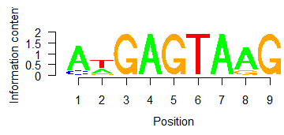
Near 5’SS, AnGA|GTAAG is found as enriched motif
iPSC-MN + Risdiplam, “Spliced Exon” from rMATS only, ±5bp from the end of the exon
Homer, background matched by ±5bp from random exons
HNDS0006_01, dPSI>0.3
HNDS0006_01, dPSI>0.1
comparison: Sivaramakrishnan, 2017
40nM
120nM
(“AAAAAGAAAGAAA” was not detected in the internal dataset)
400nM
(The other cell lines showed very similar results)
(±100bp also showed very similar result)
Notes:
C:\Users\dhuh\Desktop\Project\SMA\TST11451_SMASM_iPSCMN\analysis_motif

Slide 16
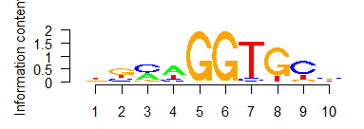
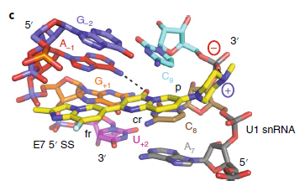
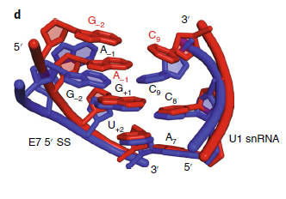
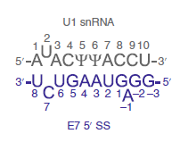
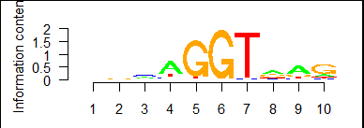
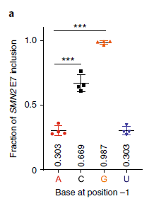
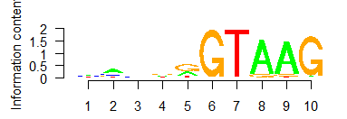
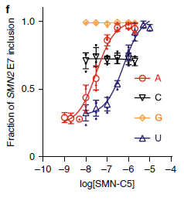
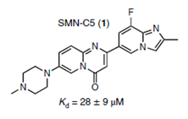
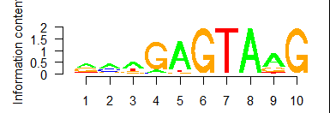
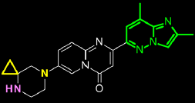
A-1G becomes an off-target only when canonical TAAG is not in place
SMN-C5
Probably GGTnnn became a weak binding site as it lost AAG to nnn, and splicing on this weak site can be enhanced by risdiplam. If the sequence were GGTAAG, it would have been spliced well to begin with, just like Campagne paper. (Sue Swalley)
-5-4-3-2-1 1 2 3 4 5
6
5
4
num. mismatch
From AnGAGTAAG
3
2
1
0
Risdiplam
-5-4-3-2-1 1 2 3 4 5
➔ splicing of off-targets with mismatches might have different structure with compound-bound form
Campagne 2019

Slide 17
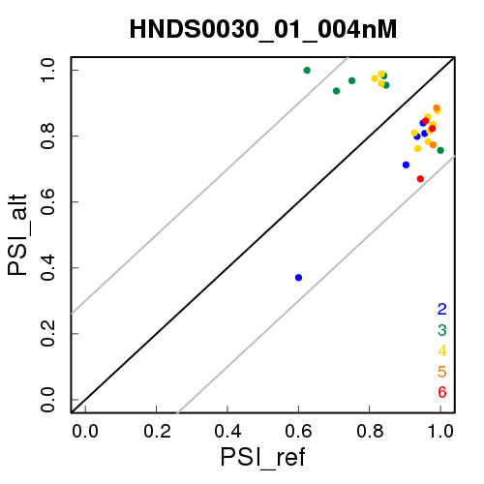
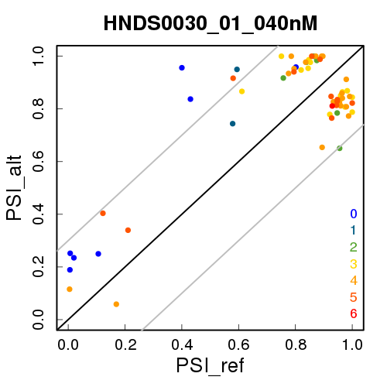
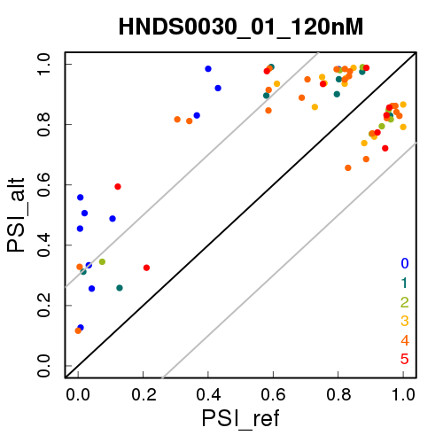
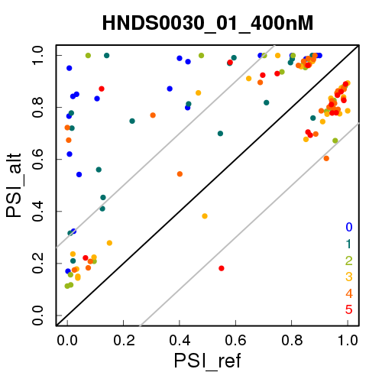
Genes with mismatches often have high PSI in DMSO
iPSC-MN from HNDS0030-01 cell line
(1x EC50)
(10x EC50)
(risdiplam)
dPSI=0.3
dPSI=-0.3
Num.mismatch
(DMSO)
Many of genes with < 2 mismatches (blue and teal ) have PSI_ref<0.5
(1.1) Genes with <2 mismatches often have dPSI>0.3 (as in slide 18)
Most of the genes with >3 mismatches (orange~red) have PSI_ref > 0.8, hence only have ~0.2 dPSI room to change.
(2.1) This is consistent with “G|GT” – the ‘canonical’ site - that appears for genes with > 3 mismatches.
(2.2) At 10x EC50, some of genes with >3 matches also have low PSI_ref, and low PSI_alt.

Slide 18
Available data sets
TST11354:
Fibroblast from SMA patient: GM03813
BIO90727, LIM070 (Branaplam), RG7916 (Risdiplam), and DMSO control
1x, 3x, 10x, 30x EC50
24-hour treatment
reference: hg19noSMN2
TST11451:
iPSC-derived motor neurons (iMN) from SMA patient lines: GM24468D, HNDS0030_01, HNDS006_01C2
RG7916 (Risdiplam), and DMSO control
0.1x, 1x, 3x, 10x EC50
24-hour treatment
reference: hg19noSMN2
TST11742:
iPSC-derived motor neurons (iMN) from SMA patient lines: GM24468D, HNDS0030_01, HNDS006_01C2
RGX-71083 (Skyhawk, but please leave this out), Risdiplam, TEC1, and DMSO.
1x, 3x, 5x, and 10x EC50.
24-hour treatment
reference: hg19noSMN2

Slide 19
Available data sets (cont’d)
TST11718:
iMN(7189L), iMN(CR001), NGN2, SHSY5Y
Cycloheximide vs DMSO treated
cytoplasmic, nucleus, and total cell
reference: GRCh38.v34
TST11726:
NGN2
~90 compounds, and DMSO
10uM concentration
reference: GRCh38.v34
TST11872:
iPSC and NGN2
10 compounds for HTT program, and DMSO (3 internal, 4 competitor benchmark, Risdiplam, Branaplam)
2 doses per compound
reference: GRCh38.v34
TST11955:
iPSC and NGN2
11 compounds for HTT program, and DMSO (9 internal, 2 competitor benchmark)
2 doses per compound: 3x and 10x EC50
reference: GRCh38.v34
TST12086:
iPSC, NGN2, and SHSY5Y
7 compounds for HTT program, and DMSO (4 internal, 3 competitor benchmark)
2 doses per compound: 3x and 10x EC50
reference: GRCh38.v34

Slide 20
Supplementary Material

Slide 21
DSG Results

Slide 22
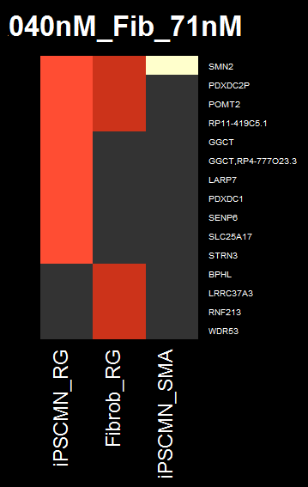
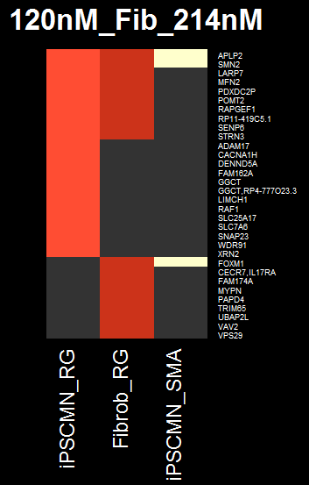
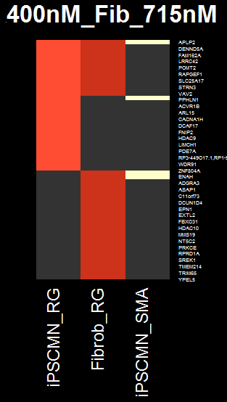
Comparison of iPSC-MN(common)+RG, Fibroblast+RG, 4 SMA vs 4 ctrl (GSE108094) : only a few genes overlap
iPSCMN 40nM, Fib 71nM
iPSCMN 120nM, Fib 214nM
iPSCMN 400nM, Fib 715nM
APLP2
SMN2
SMN2
APLP2
SMN2
CERS5
PPHLN1
FOXM1
CFAP70
CTNS
ENAH
FOXM1
➔ There are ~25% overlap between fibroblast and iPSC-MN
➔ Off-targets of risdiplam is probably NOT due to SMN normalization
➔ Subset of off-targets were sent for safety review
Notes:
grep FOXM1 res_comb_*nM_*/master_rMATS.txt | awk -F'\t' '{print $6}' | sort -u
minFDR for FOXM1: 0.08

Slide 23
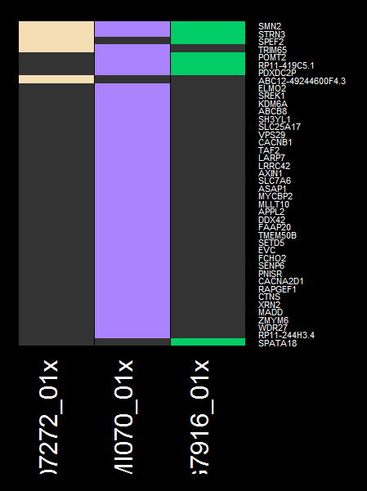
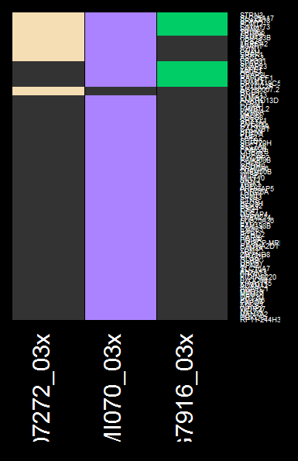
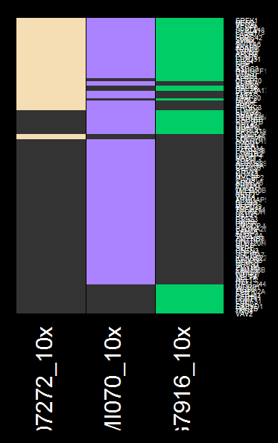
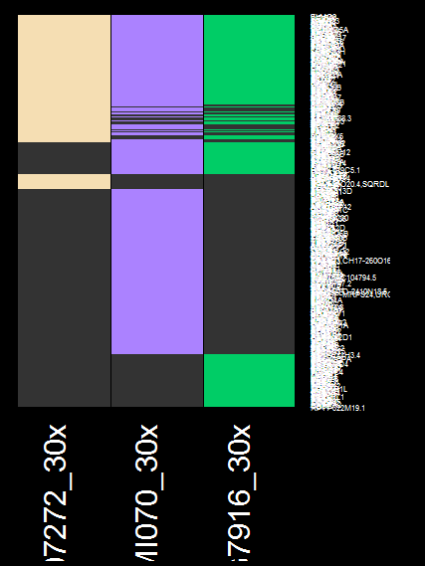
Fibroblast: Branaplam gives most different sets of spliced genes in each dose
Risdiplam
Branaplam
Branaplam
Branaplam
Branaplam
Risdiplam
Risdiplam
Risdiplam

Slide 24
Motif

Slide 25
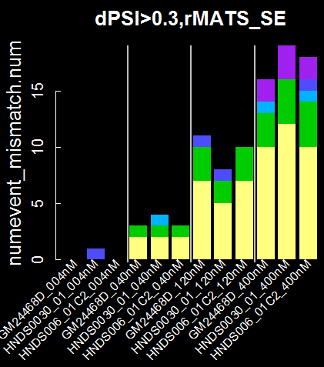
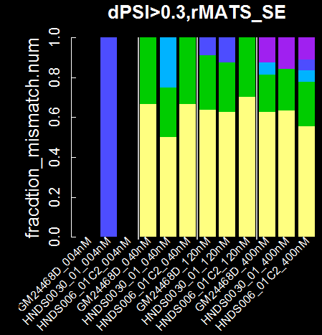


Off-targets can have mismatched motifs, across all doses of risdiplam in iPSC-MN
-5-4-3-2-1 1 2 3 4 5
Position
1~2 : always GT
-1 : A→G, canonical 5’ss?
3~5 : AAG fades
-3: A→N from 1 mismatch on.
6
5
4
num. mismatch
From AnGAGTAAG
3
2
1
0
-5-4-3-2-1 1 2 3 4 5
HTT: CAGAGTAAGGGGG
speculation:
1. 0.1 vs 0.3: Low dPSI threshold allows more fraction of mismatched motifs
=> mismatched motifs have lower probability of getting spliced.
2. Across dose: Fraction of num.mismatch do not change much as a fnc
of increasing dose => off-target motifs are expected to have similar EC50
>
dPSI
dPSI
dose
dose

Slide 26



















BIO90702, Branaplam, and Risdiplam share GAG|TAAG motif
-5-4-3-2-1 1 2 3 4 5
-5-4-3-2-1 1 2 3 4 5
90702: nnGAGTAnG
LMI070: nAGAGTAnG
RG7916: AnGAGTAAG
1. Similar progression across all three compounds:
1~2: GT
-1: A->G
3~5: AAG fades
2. Differences:
-2: 90727 and LMI070 have
stronger G-> A
-3: A in LMI070
-4: A in RG7916
-5-4-3-2-1 1 2 3 4 5
6
5
4
num. mismatch
From motif/compound
3
2
1
0
-5-4-3-2-1 1 2 3 4 5
-5-4-3-2-1 1 2 3 4 5
-5-4-3-2-1 1 2 3 4 5
-5-4-3-2-1 1 2 3 4 5
90727
LMI070
RG7916
RG7916, iPSC-MN
Notes:
Alldose, per compound

Slide 27
On-going work on the pipeline (BSSI)
Harmonization of splice events across different packages
Visualization platform for the harmonized representation
Other Application of splice-analysis pipeline
Skyhawk SMA lead molecule off-target analysis
SM splice modulator (Jessica Hurt)

Slide 30



DEG of RNA-seq on fibroblast and iPSC-MN
Fibroblast: more splice off-targets
are detected than reported
iPSC-MN: >50% DEGs
are cell-line specific
Fibroblast ≠ iPSC-MN:
<15% of DEG are shared
Current expr only
1
Unique to cell line
BIO
1790727
In both
2
In 2 cell lines
Publication^{[1]} only
Cell lines
3
In all 3
…
Fibroblast only
Shared
Number of DEG
Risdiplam
iPSC-MN only
There is no enriched pathway for DEGs
Branaplam
Number of DEG
Number of DEG
Risdiplam has fewer DEGs
than Branaplam
Number of DEG is
similar to fibroblast
[1] Sivaramakhrisian, 2017
(*EC50)

Slide 31
FOXM1

Slide 32



Differential splicing of FOXM1 in fibroblast+risdiplam is a different event from SMA iPSC-MN
Fibroblast+risdiplam (TST11354)
DMSO
01x
03x
10x
30x
Ratni et al
(flipped)
iPSC-MN from SMA vs control (GSE108094)
control
SMA
➔ FOXM1 differential splicing in Fib+Risdiplam is likely due to the compound,
not due to normalization of SMN protein level

Slide 53




In iPSC-MN, FOXM1 is mostly expressed in proliferating progenitor cells
FOXM1 splicing was not detected in iPSC-MN+risdiplam, unlike fibroblast+risdiplam.
FOXM1 expression was low in iPSC-MN(+risdiplam) , which explains this discrepancy.
➔ This difference can be attributed to the fraction of proliferating cells in fibroblast vs iPSC-MN
previous single-cell RNA-seq data of iPSC-MN (with Shila) shows that FOXM1 is expressed almost
exclusively in proliferating progenitors, but not in post-mitotic cells.
➔ To fully account for the discrepancy, cell-type composition in current bulk RNA-seq (TST11451) should be estimated (not done).
Notes:
C:\Users\dhuh\Desktop\Project\SMA\TST11451_SMASM_iPSCMN\analysis_compare_scRNA_seq
C:\Users\dhuh\Desktop\Project\SMA\TST11451_SMASM_iPSCMN\analysis_compare_scRNA_seq\01.iPSCMNre_goi_plot

Slide 54
DEG

Slide 55





Common DEG across different cell lines
Common_genes
CTTNBP2
ENSG00000260398
LRRC15
WDR91
WFIKKN1
FDR<0.05, |log2(FC)| > 1
GALC
PEPD
PMS1
SLC24A3
THSD7B
XRN2
PDXDC1
TSPAN7
TEX21P up-regulated (>2x) in 120nM+ dosing,
Except for GM24468D cell line
(p.adj=NA due to low counts, but p.val<1e-7)
0 3 17 42 genes
004 040 120 400nM
Up and Down
in RG7916 group
GM24468D
HNDS0030_01
HNDS005_01C2
Notes:
C:\Users\dhuh\Desktop\Project\SMA\TST11451_SMASM_iPSCMN\analysis_DEG\03.DEG_anal\thr_LFC_1.0_FDR_0.05
C:\Users\dhuh\Desktop\Project\SMA\TST11451_SMASM_iPSCMN\analysis_DEG\03.DEG_anal\common_DEG

Slide 56



DEG comparison: ~15% overlap between fibroblast and iPSC-MN
WFIKKN1 ENSG00000272263
HAVCR2
TEX21P
WDR91
WFIKKN1
ATAD2B
WDR91
GALC
TNS3
COP1
DENND1A
DENND5A
HLTF
HPF1
HSD17B12
LNPK
PCM1
PDXDC1
PMS1
STAT1
TAF2
WAC-AS1
XRN2
GALC
PDXDC1
Common across 3 iPSC-MN cell lines
FDR<0.05, |log2(FC)| > 1
Notes:
C:\Users\dhuh\Desktop\Project\SMA\TST11451_SMASM_iPSCMN\analysis_DEG\04.DEG_anal_overlapping_genes_fib_MN

Slide 57

Adandum 20210519: FOXM1 exon9 has the risdiplam motif
SMA fibroblast
Exon9 of FOXM1
90702: nnGA|GTAnG
LMI070: nAGA|GTAnG
RG7916: AnGA|GTAAG
09727 10X
Revcomp:
90702: CnTAC|TCnn
LMI070: CnTAC|TCTn
RG7916: CTTAC|TCnT
DMSO
Exon9 3’:
CTTAC|TGAT
Brana
➔ One mismatch
Exon9 middle:
CTTAC|TCAT
Risd
➔ Perfect match
Notes:
Alldose, per compound

Slide 58



PCA from TPM – PC2~cell line. PC1?? (not dose)
20190913095214

Slide 59


20190913095229: the same

Slide 60







PCA from TPM, per cell line ➔ none sense

Slide 61

Euclidian distance, hierarchical clustering on vst

Slide 62
Prev

Slide 63
Splicing:
Setting cutoffs for dPSI

Slide 64
Criteria for dPSI and related parameters
(1) Minimal set of splice isoforms that explain biological signature
➔ no phenotype available.
(2) Data-driven:
a. upper bound: SMN2 must be included
b. lower bound: null-comparison should give (close to) no positive signal
c. consistency: junctions significant in lower dose should
also be significant at higher dose, with consistent direction
➔ These will depend on effect size, within- and between- sample variability, read depth, and sample size.
➔ Parameter set for this experiment is not transferrable to other experiment.

Slide 65
Optimal parameters set by consistency measure
(2) Data-driven
a. upper bound: SMN2 must be included
b. lower bound: null-comparison should give no positive signal
c. consistency: junctions significant in lower dose should
also be significant at higher dose, with consistent direction
accepted pattern (all)
dPSI
(junction level)
dose
dose
dose
dose
dose
, and their reflection on x-axis
rejected pattern (partial)
dPSI
(junction level)
...
dose
dose
dose
dose
dose
, and their reflection on x-axis

Slide 66



Compound Alias
Current experiment
BIO-1790727
Sivaramakrishnan
LMI070, Branaplam, NVS-SM1, BIO-1755497
“Compound 10”
SMN-C3
Ratni
RG7916, Risdiplam,
BIO-1949634
“Compound 2”
RG7800
Notes:
BIO-1790727 is what the BioAssays and HTS group use as a positive control (lower tox than LMI070)
LMI070, BIO-1755497, Branaplam, NVS-SM1
SMN-C2 is BIO-1932671
RG7916, Risdiplam, free base version of the compound is BIO-1949634
RG7916 more soluble HCl salt is BIO-1949634
SMN-C3 – I do not know. (However, we have an analog (missing a methyl group) of SMN-C3 called BIO-1932673.)
Siva would be able to give you the BIO #s that I don’t have.

Slide 67
Differential Expression:
Comparison with patient-derived iPSC-derived motor neurons

Slide 68



Due to the cell-line effect, PC1 is regressed from the RNA-seq data of iPSC-derived motor neurons
Question: How many of the DEG from our current experiment are off-target effect?
≈ Can compound treatments reverse gene-expression signature?
➔ RNA-seq data from iPSC-derived motor neuron, patient line vs control line [Rizzo F, Brain, 2019. GSE108094]
Fastq are downloaded and re-processed
No PC1 reg
RNA-seq design:
Ctrl MN1 replicate 1
Ctrl MN1 replicate 2
Ctrl MN2 replicate 1
Ctrl MN2 replicate 2
SMN MN1 replicate 1
SMN MN1 replicate 2
SMN MN2 replicate 1
SMN MN2 replicate 2
w/ PC1 reg
Notes:
PC1: regress out.
-43.486253 -47.250285 -6.810535 -5.822279 -83.487053 -87.860717 138.379831 136.337290
PC2: disease-control
-2.776975 5.385721 -99.801455 -108.816170 60.273263 71.769431 36.160256 37.805929

Slide 69
Packages and Algorithms

Slide 70




rMATS: Exon centric, UTR considered, no novel jnc
input: .bam and reference
output: type specific (e.g., SE, A5SS) PSI, dPSI, foldchange, pval, FDR, exon coord.

Slide 71

Leafcutter: intron centric, PSI per cluster, novel jnc
input: .bam (.gtf comes later)
output: intron cluster significance, PSI and dPSI per cluster, logFC, intron coord,
but NO p.val for PSI/dPSI

Slide 72












Leafcutter: Dirichlet-multinomial generalized linear model
i.e., multinomial with dispersion
“x_{i}” is not explained in the paper

Slide 73



MAJIQ: Junction centric, novel jnc
different “PSI”: “Percent Selected Index”, ➔ I’ll call LPSI
not “percent splice included”
LSV: “Local Junction Variant” – does not directly report exon inclusion/exclusion
A5SS, A3SS included.
input: .bam and reference
output: LSV coord, LPSI and dLSPI, Prob(|dLPSI| > thr_p)

Slide 74

MAJIQ: Junction centric, novel jnc

Slide 75






MAJIQ: Junction centric, novel jnc
J = number of junctions
input: .bam and reference
output: LSV coord, LPSI and dLSPI, Prob(|dLPSI| > thr_p)

Slide 76

dPSI threshold – leafcutter, RG7916 and cell-line difference

Slide 77



Example: rMATS , thr_dSPI = 0.30, thr_maxjnc=50, null-comparison
Showing FDR<0.05
(not p.val)
Thr_dPSI=0.25 still leaves 5~10 false discovery (in leafcutter, these are zero)

Slide 78







Example: rMATS , thr_dSPI = 0.30, thr_maxjnc=50
Genes with junctions passed consistency filter
unwanted
Ideally
Zero
Genes with junctions passed FDR<0.05 & dPSI < xx
& <max.jnc> > 50 at the highest conc.
At thr_dSPI=0.30 and thr_maxjnc=50, there are 1, 1, and 0 inconsistent genes for GM, HNDS006, and HNDS003
➔ thr_dPSI=0.20 can do the same, but this is below the lower bound

Slide 79

dPSI threshold – leafcutter, randomized – all zero.

Slide 80

leafcutter , thr_dSPI = 0.20
unwanted
Genes with junctions passed consistency filter
Ideally
Zero
Genes with junctions passed FDR<0.05 & dPSI < xx
At thr_dSPI=0.20, there are 0, 0, and 1 inconsistent genes for GM, HNDS006, and HNDS003
➔ thr_dPSI=0.20 can do the same, but this is below the lower bound

Slide 81


About 75% of DSG exclusively called in leafcutter, are non-annotated
Check annotation vs cryptic using leafcutter result, and count genes.
In Leafcutter, not in rMATS or Majiq:
DSG in leafcutter, all.
This might be true for any leafcutter DSG in general
➔ no, overlap with rMATs must be annotated.
Haven’t checked the overlap numbers and thresholds.

Slide 82




Common DSG across different cell lines
004nM
040nM
120nM
400nM

Slide 83


GSE108094, 4 SMA vs 4 ctrl, and null set
Showing FDR<0.05 (not p.val)
rMATS: thr_maxjnc=50, thr_dPSI=0.25
Leafcutter: thr_dPSI=0.20
as in iPSCMN
no other guidance.
mj: EdPSI=0.3 and PdPSI> 0.9.
(SMN2 is excluded, (PdPSI~0.4), but the next option is EdPSI>0.2, which is not ideal.
Null set A seems to be probalmatic.

Slide 84



Overlap btw iPSC-MN(common)+RG, Fibroblast+RG
(120,214)
(400,715)
(40,71)nM

Slide 85


Differentially expressed genes

Slide 86




Per cell line, 1.5x change
Common_genes
Up and Down
in RG7916 group
FDR<0.05, |log2(FC)| > 0.58 (1.5x)
Notes:
C:\Users\dhuh\Desktop\Project\SMA\TST11451_SMASM_iPSCMN\analysis_DEG\03.DEG_anal\thr_LFC_1.0_FDR_0.05

Slide 87




Fibroblast, RG7916, 10x, leafcutter
(30x also shows same region spliced)
GSE108094, leafcutter
Expression in dividing vs post-mitotic cells? scRNA-seq data?

Slide 88

Fibroblast, RG7916
Showing
chr12:2,967,517-2,972,174
Ratni, flipped

Slide 89

Fibroblast, RG7916
Ratni, flipped

Slide 90

GSE108094
Showing
chr12:2,967,517-2,972,174

Slide 91

GSE108094
chr12:2973918-2975559

Slide 92

GSE108094
chr12:2973918-2975559

Slide 93

iPSC-MN, RG7916, GM24468, FOXM1 : too few reads

Slide 94

iPS-MN samples prepared for RNA-seq (for internal benchmarking of Risdiplam)
Mercedes Beyna
July 29, 2019
SMA SM Phenotypic Screen

Slide 95
FOXM1

Slide 96


Differential splicing of FOXM1 in fibroblast+risdiplam is different event from SMA iPSC-MN
Fibroblast+risdiplam (TST11354),
10x, (30x show similar result)
iPSC-MN + risdiplam (TST11451)
SMA vs control iPSC-MN (GSE108094)
➔ No differential splicing

Slide 97
Con’d
Fibroblast+risdiplam (TST11354)
Ratni et al, flipped

Slide 98
Con’d
iPSC-MN from SMA vs control (GSE108094)

Slide 99



For other genes, cell-type specific expression do not necessarily explain the discrepancy
Avarage nomarlized UMI count per cell type from scRNA-seq of iPSC-MN
z-score of <nUMI> per gene
iPSCMN 40nM, Fib 71nM
iPSCMN 120nM, Fib 214nM
Notes:
C:\Users\dhuh\Desktop\Project\SMA\TST11451_SMASM_iPSCMN\analysis_compare_scRNA_seq\01.iPSCMNre_goi_plot

Slide 100


iPSC-MN + Risdiplam, Spliced Exon from rMATS, plus minus 5bp from the end of the exon
Homer, background matched by +-5bp from random exons
dPSI> 0.3
HNDS0006_01
dPSI> 0.1
Sivaramakrishnan, 2017
Longest segment per gene, +- 100bp, from all algorithms ➔ no clear consensus sequence among cell lines.
40nM
120nM
GSE108094
dPSI>0.3, rMATS SE
All algorithms, +-100bp
400nM
The other cell type showed very similar results
➔ different motif, hence most of the spliced genes in our experiment are probably risdiplam off-targets, rather than splicing from SMN2
+-100bp also showed very similar result
Notes:
C:\Users\dhuh\Desktop\Project\SMA\TST11451_SMASM_iPSCMN\analysis_motif

Slide 101

However, structural study shows A-1G will block the efficacy of SMN-C5
RG7916, Risdiplam,
BIO-1949634
SMN-C5
-5-4-3-2-1 1 2 3 4 5
-5-4-3-2-1 1 2 3 4 5
-5-4-3-2-1 1 2 3 4 5
6
5
4
num. mismatch
From …
3
2
1
0
-5-4-3-2-1 1 2 3 4 5
-5-4-3-2-1 1 2 3 4 5
-5-4-3-2-1 1 2 3 4 5
Alldose, per compound
90727
LMI070
RG7916
Campagne 2019

Slide 102

Kondo 2015-u1snRNP structure

Slide 103



Setting dPSI cutoff: same strategy as in the fibroblast study : null-set and consistency filter
unwanted
Genes with junctions passed consistency filter
Num.FDR<0.05
Ideally
Zero
Genes with junctions
passed FDR<0.05 & dPSI < xx
& <max.jnc> > 50 at the highest conc.
At thr_dSPI=0.30 and thr_maxjnc=50, there are 1, 1, and 0 inconsistent genes for GM, HNDS006, and HNDS003
➔ thr_dPSI=0.20 can do the same, but this is below the lower bound
Null-set, FDR<0.05
➔ dPSI>0.30,

Slide 104
GSE108094

Slide 105


In 4 SMA vs 4 ctrl (GSE108094) iPSC-MN lines, dPSI is 0.3, if SMN1 and SMN2 are pooled together
SMN2
Ave(PSI_SMA) Ave(PSI_control)
rmats leafcutter majiq
➔ <PSI_SMA> is similar to TST11451
➔ Low dPSI due to low <PSI_control>:
Beware that control’s SMN1 and SMN2 are all mapped to SMN2 locus.
This can generate artifact on avePSI_control value.
➔ How come leafcutter has similar dPSI then the other two? (not investigated yet)
Notes:
Rm: upstreamES: 69366467 upstreamEE: 69366578 downstreamES: 69372845 downstreamEE: 69372987
lc "chr5:69366578:69372846“
mj: "69366578-69372846"

Slide 106

4 SMA vs 4 ctrl iPSC-MN showed 811 total DSGs
rMATS: FDR<0.05, dPSI> 0.25
(from null set, 0.30 is also OK)
Leafcutter: FDR<0.05, dPSI > 0.20
(from null set)
Majiq: P(dPSI) > 0.90, E(dPSI)>0.30
(from rMATS, but haven’t calculated 0.25)
(SMN2 is excluded from Majiq, due to dPSI=0.28)
Notes:
C:\Users\dhuh\Desktop\Project\SMA\GSE108094_iPSC_MN_SMA_vs_ctrl\analysis_02_combined_DSG\res.02.compare_plot_DSG_abThr/DSG_cellline_dose_peralg_GSE108094_lowerthr.txt
TEX21P: minFDR=0.20, Not significant.

Slide 107


Cell-line to cell-line difference, controls only:
baseline – 10~20 gene difference in DSG
HNDS006_01C2:GM24468D
GM24468D:HNDS0030_01
HNDS0030_01:HNDS006_01C2

Slide 108


SMN2 and POMT2 are consistently called differentially spliced across all compound and dose
235 genes
SMN2
POMT2
RP11-419C5.1
181 genes
403 genes
SMN2
POMT2
TRIM65
➔ No pathway enrichment for the uniquely spliced genes in x30
Common genes per dose?

Slide 109


The discrepancy is not fully explained by expression level difference
iPSCMN 40nM, Fib 71nM
TPM
iPSCMN 120nM, Fib 214nM
TPM
Notes:
grep FOXM1 res_comb_*nM_*/master_rMATS.txt | awk -F'\t' '{print $6}' | sort -u

